Slide 1
Creating a Healthy Community that Supports People of All Ages
Broome
Age-Friendly Project
Three Year Progress Report
2020-2023

Slide 2
THREE YEAR PROGRESS REPORT TABLE OF CONTENTS
Letter to the Community 3
Acknowledgements 4
Why Become Age-Friendly? 5
What is an Age-Friendly Community? 6
Broome Age-Friendly Project: Vision and Mission 7
Broome Age-Friendly Project: Goals 8
Broome Age-Friendly Project: Brief History and Domains of Livability 9
Broome Age-Friendly Project: Action Plan Overview 10
Outdoor Spaces and Public Buildings 11-12
Information and Communication 13-14
Respect and Social Inclusion, Social and Civic Participation, 15-16
and Employment
Housing 17-18
Transportation 19-20
Community Supports and Health Services 21-22
Looking Forward 23
Contact Information 24

Slide 3
FOREWARD
I am pleased to present the Broome Age-Friendly Project Three Year Progress Report 2020-2023. Broome County became a member of AARP’s Network of Age-Friendly States and Communities in 2020 with submission of our first three-year action plan of community improvements. Much has been accomplished in these past few years. Since development of the action plan, there have been new challenges and also new opportunities to innovate and work together.
As we pause and recognize the many accomplishments of these past few years, we also begin to plan for the next three years. In June 2023, we obtained preliminary results of New York State Office for Aging’s vast survey of older adults which we supplemented with a local age-friendly survey.
We are thankful for the efforts of Broome County government, the towns and cities in our county, the many community agencies who are working to improve our community, and the interns and volunteers who have contributed to our age-friendly work.
This is only the first cycle of our age-friendly efforts. We look forward to continuing the work of improving the livability of our community on an ongoing basis.
Mary Turbush, Director
Broome County Office for Aging

Slide 4
ACKNOWLEDGEMENTS
Many agencies and organizations have either been involved in implementation of the action plan or have engaged in age-friendly efforts on their own. There is an increased awareness of the need to be a more inclusive community and to consider the needs of all residents. We would like to acknowledge for their age-friendly work or involvement in the Broome Age-Friendly Project (listed in alphabetical order):
Action for Older Persons
Association for Vision Rehabilitation and Employment, Inc.
Binghamton Metropolitan Transportation Study
Binghamton University
Broome County Department of Planning & Economic Development
Broome County Department of Transportation
Broome County Health Department
Broome County Land Bank
Broome County Legislature
Broome County Parks, Recreation & Youth Services
Broome County Public Library
Broome County Senior Centers
BroomeINCLUDES
City of Binghamton Department of Planning, Housing & Economic Development
Deposit Free Library
George F. Johnson Memorial Library
JC Connects Community Schools
Lisle Free Library
Lourdes/Ascension Hospital
Lyceum, Binghamton University
Mary Wilcox Memorial Library
Memory Maker Project
Metro Interfaith Housing
New York State Office for Aging
Nineveh Public Library
Northern Broome Cares
Our Ability, Inc.
Retired Senior Volunteer Program
Rural Health Network of South Central New York
Sarah Jane Johnson Memorial Methodist Church
Southern Door Community Land Trust
Southern Tier Home Builders & Remodelers Association
Southern Tier Independence Center
SUNY Broome
The SEPP Group
Triple Cities Hiking Club
Town of Deposit
Town of Vestal
Two Rivers Greenway
UHS Health Services
United Way of Broome County
University of Buffalo Center for Inclusive Design and Environmental Access
Urban League
Vestal High School
Vestal Public Library
Your Home Public Library
A Special Thanks to Broome County Office for Aging Interns: Joseph Kovar, Sarah Ludwig, Christina Olverd,
Josie Sandor, Elliot Townsend, Chen Wu

Slide 5
WHY BECOME AGE-FRIENDLY?
Broome County’s 60+ population is growing: estimated at 27% of the total population in the 2020 Census and will increase to about 30% by 2025
Older adults contribute socially and economically to the community
Most people want to remain in their own homes as they age
Efforts to design and adapt the built environment benefits people of all ages – for example, curb cuts that are good for a walker or wheelchair are also good for a bike or stroller
Age-friendly communities promote health across the lifespan and reduce inequities
Creates a more inclusive community that fosters bonds between the generations

Slide 6
WHAT IS AN AGE-FRIENDLY COMMUNITY?
Recognizes the wide range of capacities and resources among older people and people of all ages
Anticipates and responds flexibly to aging-related needs and preferences
Realizes that most people want to remain in their own homes as they age
Respects older persons’ decisions and lifestyle choices
Protects those who are most vulnerable
Promotes older persons’ inclusion in and contribution to all areas of community life

Slide 7
BROOME AGE-FRIENDLY PROJECT
Vision
We envision Broome County as a great place to live and a community that encourages healthy, safe, and active aging for people of all ages.
Mission
The Broome Age-Friendly Project is dedicated to supporting and encouraging community programs, new projects and enhancements that allow people of all ages to stay connected, independent, active and healthy.

Slide 8
BROOME AGE-FRIENDLY PROJECT
Goals together nmakresi
To make Broome County a more attractive and livable community for people of all ages
To provide optimal access to safe and appropriate housing, health care, community mobility and civic engagement activities that enable meaningful social participation and maximize quality of life
To foster an inclusive community where people’s decisions and life choices are respected
To anticipate and respond flexibly to the changing needs of our county
To enhance community partnerships
To have data to support funding applications for community projects
To support efforts to achieve the vision of New York State as the first Age-Friendly State in the United States

Slide 9
BROOME AGE-FRIENDLY PROJECT
Brief History
2018: The age-friendly planning process began to address the domains that make a community livable (see list of domains below)
2019: A Community Needs Survey was completed by 2,157 residents age 55+
2019-2020: Workgroups met to review data and community needs, determine priorities, and create an action plan
2020: AARP approved Broome County’s multi-year action plan
2020-2023: Implementation of the action plan with annual status updates published
2023: A new brief community survey of Broome County residents age 55+ was conducted, this three year progress report was created, and a new three year action plan will be submitted to AARP
Domains of Livability
Outdoor Spaces and Public Buildings
Community Supports & Health Services
Transportation
Respect, Social Inclusion, Social and Civic Participation, Employment
Housing
Communication and Information

Slide 10
BROOME AGE-FRIENDLY PROJECT
Action Plan Overview
In 2020, Broome County was accepted into AARP’s Network of Age-Friendly States and Communities through Office for Aging’s (OFA) submission of a multi-year action plan for community improvements to address the needs of older adults and people of all ages. This was the culmination of several years of planning, results of a large community survey, and workgroup meetings to determine initial age-friendly goals.
The initial action plan was developed through an inclusive planning process that engaged professionals and community members in a variety of age-friendly events and workgroups. OFA was also awarded an age-friendly planning grant from New York State Office for Aging.
Since 2020, OFA has worked on the action steps, engaged in a number of pilot projects, facilitated ad hoc and ongoing workgroups, and tracked the work of government agencies and community organizations that align with the goals of the action plan. With the COVID-19 pandemic, some action steps were delayed or revised, and new initiatives were developed that had not been part of the initial plan. OFA continues to devote considerable resources to combatting some of the ongoing impacts of the pandemic, such as social isolation.
This report highlights some of the accomplishments of implementation of the action plan. The full action plan, annual progress reports, and other age-friendly information is available on Office for Aging’s website: https://www.gobroomecounty.com/senior/Age-FriendlyCommunityInformation

Slide 11
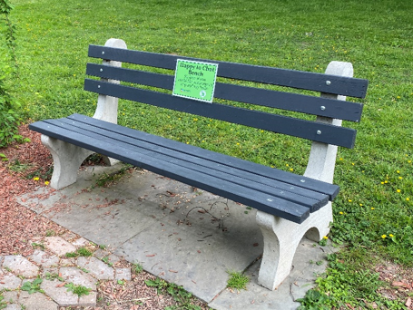
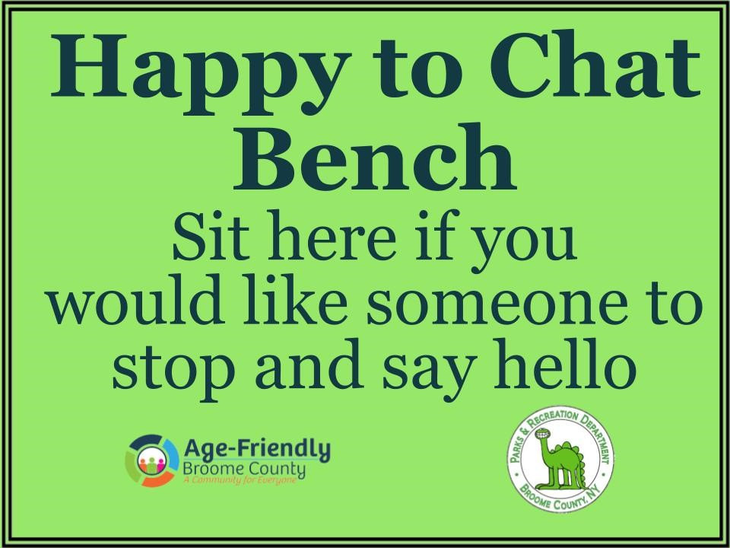
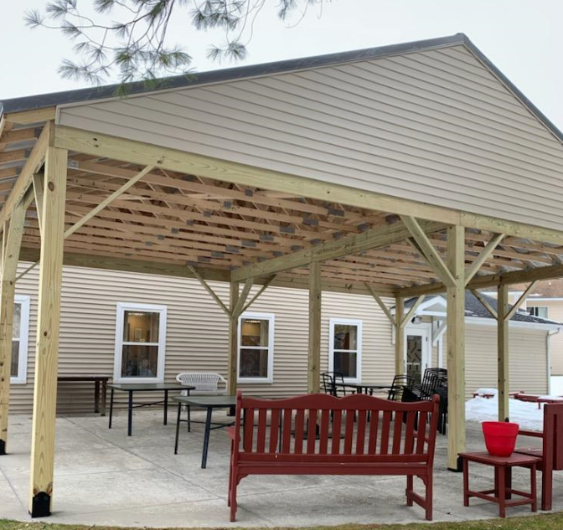
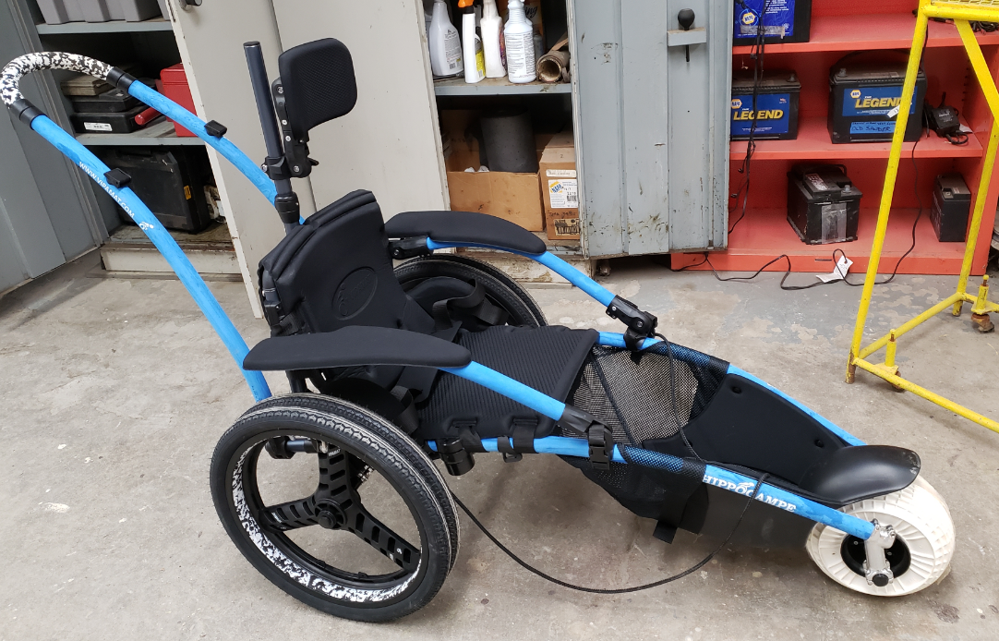
Outdoor Spaces and Public Buildings
The built environment is a critical element of an active community life. Age-friendly outdoor spaces and public buildings are attractive, accessible, and offer opportunities for people of all ages to benefit from community spaces.
Happy to Chat Bench Project (Otsiningo Park, Roundtop Picnic Area, and Deposit)
All-Terrain Beach Wheelchair
Part of Pathways to Play:
Dorchester Park Accessibility Improvements
Broome West Senior Center Pavilion

Slide 12
Outdoor Spaces and Public Buildings
HIGHLIGHTS (2020-2023)
Dorchester Park accessibility improvements: beach wheelchair, wheelchair accessible boat launch, and a fully accessible playground.
Broome County ADA Transition Plan for Pedestrian Facilities/Physical Barriers was updated.
County facility improvements: construction of a pavilion for outdoor programs at Northern Broome Senior Center, LED lighting at Broome West Senior Center.
Binghamton’s State Street reconstruction included benches, bike parking posts, curb extensions, a raised mid-block crosswalk, and street signage.
US11/Front Street Bridge over I-81 including a multi-use trail on the bridge with connection to the Front Street Trail, Otsiningo Park trails, Sunrise Terrace community, the Broome County Farmers Market and beyond.
Park improvements such as intergenerational swings at African Road Park in Vestal and rebuilt accessible playground and sensory garden at Recreation Park in Binghamton.
BC Transit urban-to-rural excursion buses for Cole Park Beach Fest.
BMTS conducted a Complete Streets Workshop in Johnson City to look at needs and possible improvements.
Raised flower beds were built for residents of Willow Point.
OFA and Broome County Planning hosted a Universal Design Municipal Training with an expert from the University of Buffalo’s Center for Inclusive Design and Environmental Access.
OFA’s Senior News monthly newsletter now features a “Mark Your Calendar” article featuring a variety of activities/events each month.
OFA offers a monthly Nature Walking Club.
The Binghamton Bridge Pedal now offers a senior discount.
The large Two Rivers Greenway Project includes pedestrian and bicycle trails and amenities.

Slide 13
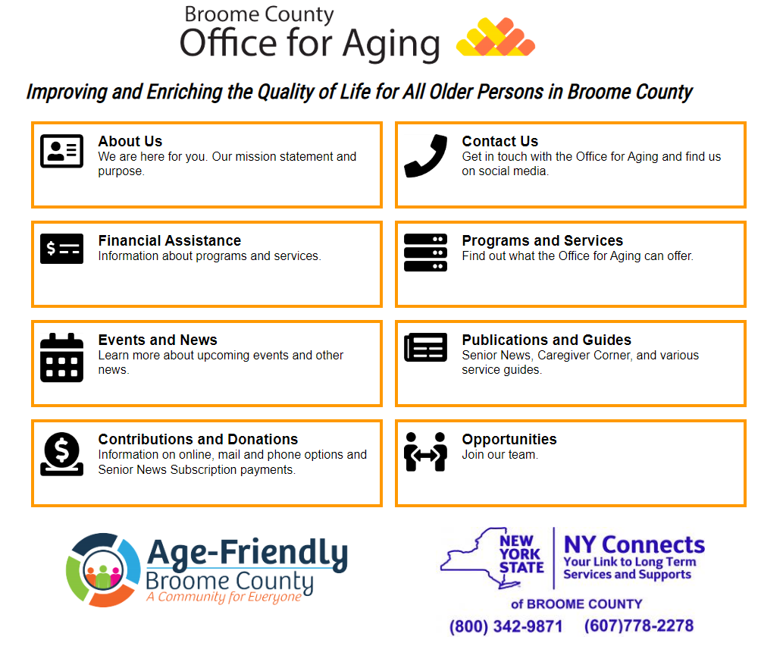
Information and Communication
Individuals need information and clear communication to connect to the community. Age-friendly communities provide accessible information in a variety of formats to reach all residents. Internet access and tech education has become a necessity.
Technology Resources Flyer
Federal Communications Commissions program for affordable internet access
Broome County Office for Aging website redesigned using age-friendly communications standards

Slide 14
Information and Communication
HIGHLIGHTS (2020-2023)
Creation of an “Age-Friendly Communication Fact Sheet” with best practices for print, verbal, tv/radio and digital communication was distributed to businesses, nonprofits, government, education, cultural and entertainment venues.
Office for Aging redesigned its’ website to be more user friendly.
The “Elder Services Guide” was updated and renamed the “Broome County Directory for Older Adults” with enhanced information about community resources such as “Social, Recreational & Learning Activities.”
Creation/distribution of promotional bags and pens with the Broome Age-Friendly Project logo to increase age-friendly visibility.
The national Affordable Connectivity Program assists low-income households with affordable internet through a $30 monthly service discount. This went from being a short-term program during the pandemic to a long-term program. OFA has publicized this program and assisted with the application process.
Office for Aging researched and published “Technology Resources in Broome County,” a flyer of local and online resources.
Through collaboration with local libraries, three senior centers now offer 1-1 tech support appointments on-site for assistance with learning personal smart phones, tablets or laptops.
The New York State Broadband Assessment Program conducted a survey and speed tests across NYS to identify rural areas without internet coverage. There is more work to be done but there has been progress.
Office for Aging promoted the Virtual Senior Center and GetSetUp to make older adults aware of virtual platforms available through New York State Office for Aging.
Office for Aging distributed 20 tablets with 4G internet service to vulnerable, isolated older adults and provided individualized tech support.
OFA contracted with Lyceum Lifelong Learning Center to offer the Armchair Travel series at several senior centers.
OFA piloted the Blooming Health communication platform to provide emergent information such as agency closings and outreach about benefit programs through text message, email and voice calls.

Slide 15
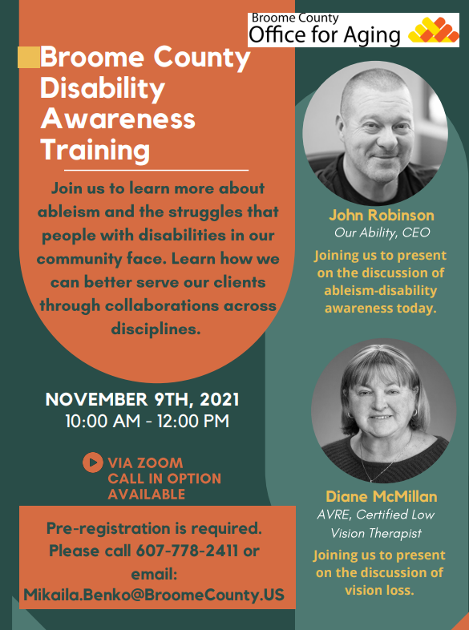
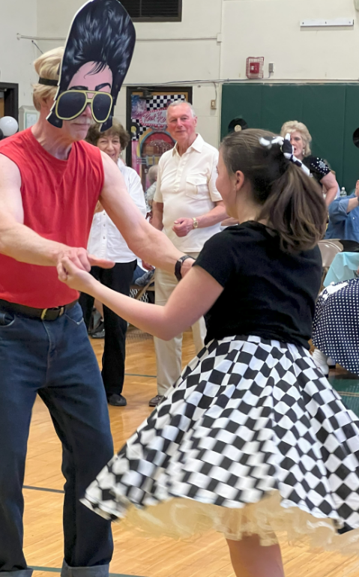
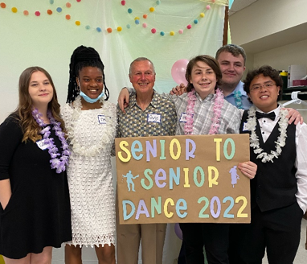
Respect and Social Inclusion, Social and Civic Participation, and Employment
People benefit from being engaged in their community at every stage of life. Communities need a variety of accessible, affordable and fun social activities, intergenerational gatherings, and volunteer and employment activities.
Inclusivity Workshop
Intergenerational Dinner Dances
in Vestal and Johnson City
Disability Awareness Training

Slide 16
Respect and Social Inclusion, Social and Civic Participation, and Employment
HIGHLIGHTS (2020-2023)
OFA hosted an Inclusivity Workshop presented by the BroomeINCLUDES Coordinator. It provided information on physical, programmatic, administrative, and social inclusivity.
Through a NYS Disability Grant, OFA hosted a Disability Awareness Training with speakers from Our Ability, Inc. and the Association for Vision Rehabilitation and Employment, Inc.
BroomeINCLUDES offers Inclusivity Assessments by a Certified Inclusivity Assessor and has assessed three Broome County senior centers.
United Way of Broome County launched the volunteer matching website “Volunteer HQ.”
The Senior News has featured articles on volunteerism and volunteer opportunities such as “Age Well by Giving Back” and “Age Well with the Yesteryears Social Day Program.”
OFA initiated inclusivity practices such as creating a new “Diversity, Equity, Inclusion, and Accessibility Workforce Statement,” displaying LGBTQ+ posters at the senior centers to welcome older adults who identify as LGBTQ+, and starting a new group for LGBTQ+ older adults.
A number of parks have received accessibility and intergenerational equipment updates, including Dorchester Park, African Road Park in Vestal, Ethel Park in Vestal, and Rec Park in Binghamton.
The “Happy to Chat” bench project was piloted at Otsiningo Park and Roundtop Picnic Area to combat social isolation and facilitate interaction.
Several new intergenerational programs were organized and implemented:
The Senior to Senior Dinner Dance was a collaboration of Johnson City Senior Center, Johnson City Community Schools, Binghamton University, Sarah Jane Memorial United Methodist Church, and OFA.
The Senior Sock Hop was a collaboration of Vestal Senior Center, Vestal High School, the Town of Vestal, and OFA.
The “Between the Lines” intergenerational book and discussion group met at Johnson City Senior Center and the Vestal Public Library.

Slide 17
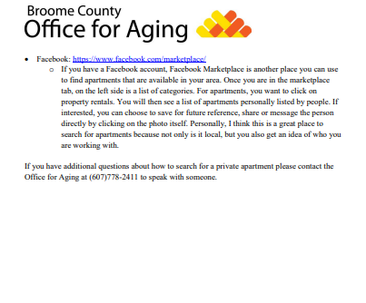
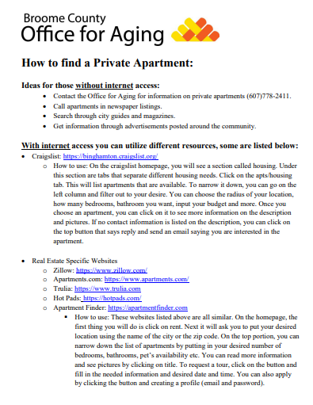
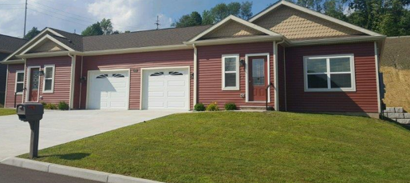
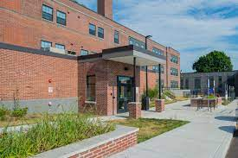
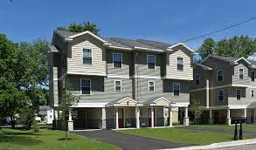
Housing
Most older adults want to reside in their current home or community and may need modifications to age-in-place. There should be a range of housing options suitable for people of all incomes, ages and life stages.
“How to Find a Private Apartment” guide
New housing (clockwise from top left: Skye View Heights, Endicott Square, Fairmont Park Apartments

Slide 18
Housing
HIGHLIGHTS (2020-2023)
The BAFP Housing workgroup advocated for affordable and senior housing needs with local entities including housing developers and government agencies.
OFA continuously provides Letters of Support for grant applications by nonprofit housing agencies developing new housing.
OFA participated in the NYS Health, Housing and Longevity Learning Collaborative through the New York Academy of Medicine.
OFA was granted an Emergency Solutions Grant which funded a Housing Specialist who assisted Broome County residents who were unhoused or facing homelessness to find safe and affordable housing.
OFA created a “How to Find a Private Apartment” document to assist renters who do not qualify for subsidized housing but have limited means. NY Connects caseworkers are continually educating the public about housing options for low, middle-income, and rural residents.
An “Income-Based Apartment Guide” was created by OFA staff to assist older adults navigating the rental market.
Through the Senior News, OFA provided education on home repair and modification programs, hiring contractors, and avoiding contractor scams.
Broome County Department of Planning and Economic Development conducted a “Housing Needs Assessment” survey.
Completed housing and housing funding (additional projects are currently in development):
Fairmont Park Apartments: 17 two-bedroom and 17 three-bedroom units in the Town of Union. The units are energy efficient, affordable apartments with two fully accessible units.
Hamilton House, Binghamton: received 20 years of funding for very low-income individuals to qualify for 17 units of affordable housing.
Skye View Heights, Endicott: 120 units of rental housing for those aged 55+ with higher incomes.
Endicott Square, Endicott: 61 affordable units including 7 fully accessible units for persons who have mobility impairments, 3 units adapted for persons who have hearing and/or vision impairments, and 15 apartments for families who were previously homeless.

Slide 19
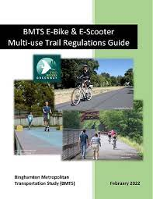
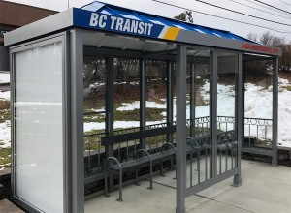
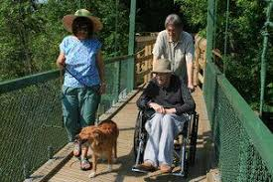
Transportation
Adequate, safe and affordable transportation is critical to an age-friendly community. Safe streets, sidewalks, and crosswalks are essential as are alternatives to driving for those who need to move around the community for access to services and for social and civic participation.
“See! Be Seen!” Public Service Announcements
BC Transit Bus Shelters
BMTS E-Bike &
E-Scooter Multi-Use Trail Regulations Guide

Slide 20
Transportation
HIGHLIGHTS (2020-2023)
OFA provides funding to Getthere mobility management to serve more clients and supplement gaps in public transportation options for rural to urban travel.
The bimonthly Getthere Mobility Management Advisory Council continues to engage in planning efforts to address rural-to-urban transportation needs.
Binghamton Metropolitan Transportation Study (BMTS) conducted a “Coordinated Transportation Plan Study.”
Free taxi service and assistance from Getthere mobility management are part of Northern Broome Cares serving rural residents in Whitney Point, Barker, Lisle, Nanticoke, and Triangle.
Four NYS Department of Transportation “See! Be Seen!” pedestrian safety PSAs were featured on OFA’s Facebook page and BMTS’ website and YouTube channel.
BC Transit installed 30 new bus shelters.
BC Transit made it easier to navigate the public transportation system through customized route information on their website, Apple Maps and Google Maps. The Double Map app allows riders to easily track their bus’ location on computer, tablet or smart phone.
BMTS’ Pedestrian and Bicycle Advisory Committee completed the “BMTS E-bike and E-Scooter Multi-Use Trail Regulations Guide.”
BMTS hosted a virtual Complete Streets Walk the Streets Workshop in Johnson City to look at possible neighborhood improvements.
OFA received a Technical Assistance Grant from CTAA to work on inclusive transportation planning. Several focus groups were held at senior centers.
A new “Bus Ambassador” program was started by Office for Aging to support and educate residents of senior housing on using public transportation.
BMTS conducted a “Coordinated Transportation Survey” in summer 2023.
With the rollout of the covid vaccine, Getthere, a program of the Rural Health Network, provided free transportation to vaccine clinics.

Slide 21
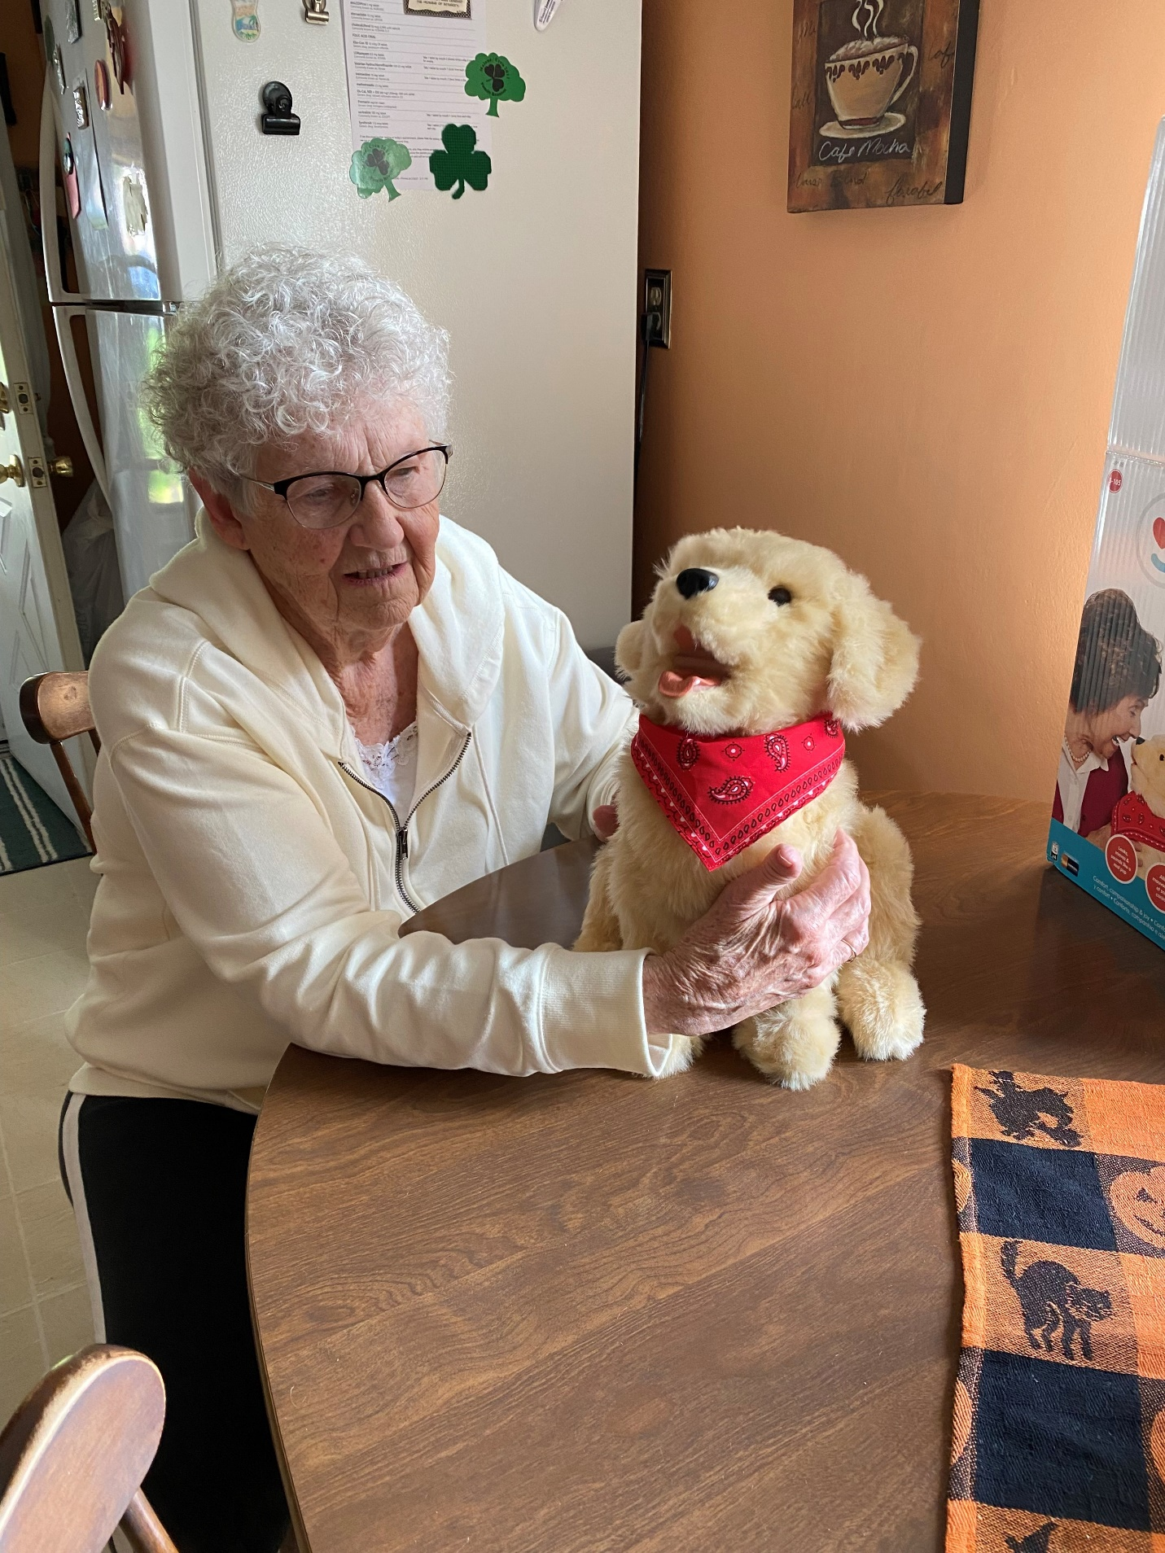
Community Support and
Health Services
People need accessible and affordable health services and appropriate community supports.
Robotic Companion Pet Project
Telehealth Cart at Eastern Broome Senior Center in Harpursville
Virtual Senior Center
One of Many Initiatives to Address Social Isolation

Slide 22
Community Supports and Health Services
HIGHLIGHTS (2020-2023)
OFA successfully opened Chenango Bridge Senior Center in 2022 to meet community needs.
Several Broome County senior centers offer blood pressure, glucose/diabetes checks, flu and covid vaccine clinics. At several senior centers, Binghamton University’s Physical Therapy Department offers balance clinics and conducts research to improve fall outcomes.
Through a Care Compass Network grant, Northern Broome Cares offered a tablet/mobile hotspot loan program to facilitate access to health education classes, telehealth appointments, and a variety of other health-related activities.
Two of the major hospital systems in Broome County are part of the Institute for Healthcare Improvement’s Age-Friendly Health System Initiatives which includes the age-friendliness of emergency room care.
In partnership with Lourdes, Eastern Broome Senior Center now offers a mobile telehealth unit in a rural area without local primary care.
BroomeINCLUDES has a public education campaign which includes Broome County Suicide Awareness for Everyone (BC Safe) and provides information on mental health topics including how nutrition impacts mental health and how to deal with stress and anxiety.
To improve public awareness of community resources, the Senior News monthly newsletter now includes a new Q&A format column on the many ways NY Connects can assist.
OFA hired an AmeriCorp worker as a Social Isolation Prevention Coordinator.
Through two pilot projects, OFA distributed robotic companion pets (dogs, cats, birds) and ELLiQ Companion Robots to provide social support to isolated older adults.
Northern Broome Cares provides transportation, shopping assistance, care management, telephone reassurance, emergency call buttons, health education, safety assessments, and accessibility home modification in Whitney Point, Barker, Lisle, Nanticoke, and Triangle.
New community resources: Greater Good Grocery store in a former food desert in Binghamton, food basket home delivery to older adults in Deposit (discontinued due to lack of interest), Vestal High School food pantry, Johnson City High School food pantry and clothing center, Union-Endicott School District food center, Vestal Public Library Bound to Please: Homebound Books delivery program, Broome County Public Library’s partnership with Catholic Charities to provide a peer advocacy program (counseling, housing referrals, and food).
OFA piloted the Guaranteed Aide Program to eliminate the waitlist for home care service through EISEP (Expanded In-home Services for the Elderly Program).
The Fair Wage Act was enacted in NYS to provide higher wages for home care aides.
The LifeSpan Respite Voucher Program provided monetary assistance for caregiver respite.

Slide 23
Looking Forward
Where do we go from here?
Thank you for taking the time to review some highlights from the past three years. As the age-friendly process and program cycle is one of continuous improvement, a new action plan is being developed for the next three years, 2023-2026. This action plan will be submitted to AARP for continued membership in the AARP Network of Age-Friendly States and Communities.
In developing this plan, results of surveys conducted in 2023 will be consulted:
The first-ever comprehensive Community Assessment Survey for Older Adults conducted by New York State Office for Aging
Binghamton Metropolitan Transportation Study Coordinated Public Transit/Human Services Survey
Broome County Planning and Economic Development Department’s Housing Needs Assessment
The Broome Age-Friendly Project’s Survey of Adults Age 55+
Please check the website on the following page to follow our progress and for information on how you can provide input or get involved as we work to create a community that supports people of all ages!

Slide 24
For More Information or to Find Out How You Can Help Broome County Become More Age-Friendly:
Call: Broome County Office for Aging 607-778-2411
Email: OFA@broomecountyny.gov
Mail: PO Box 1766, Binghamton, NY 13902
www.gobroomecounty.com/senior
The AARP Network of Age-Friendly
States and Communities:
www.AARP.org/Livable

