Slide 1

Solar Development
Guidance for Solar Development Within the Special Flood Hazard Area.

Slide 2
Presenter
Devin Prine
Environmental Program Specialist,
Western Flood HUB, New York State Department of Environmental Conservation.
Position Overview:
Provides technical assistance to communities participating in the National Flood Insurance Program.
Performs Community Assistance Visits and Contacts on behalf of FEMA.
Assists communities in adopting maps during regulatory map updates.

Slide 3
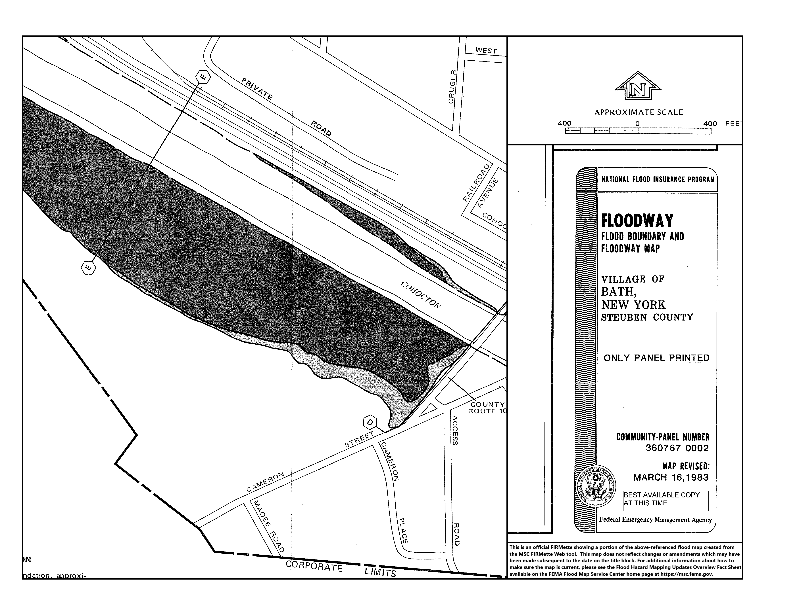
How to determine if the project is in the floodplain
To determine if a project is located in the special flood hazard area, you must use the effective Flood Insurance Rate Maps.
Digital FIRMette
Paper FIRMette

Slide 4
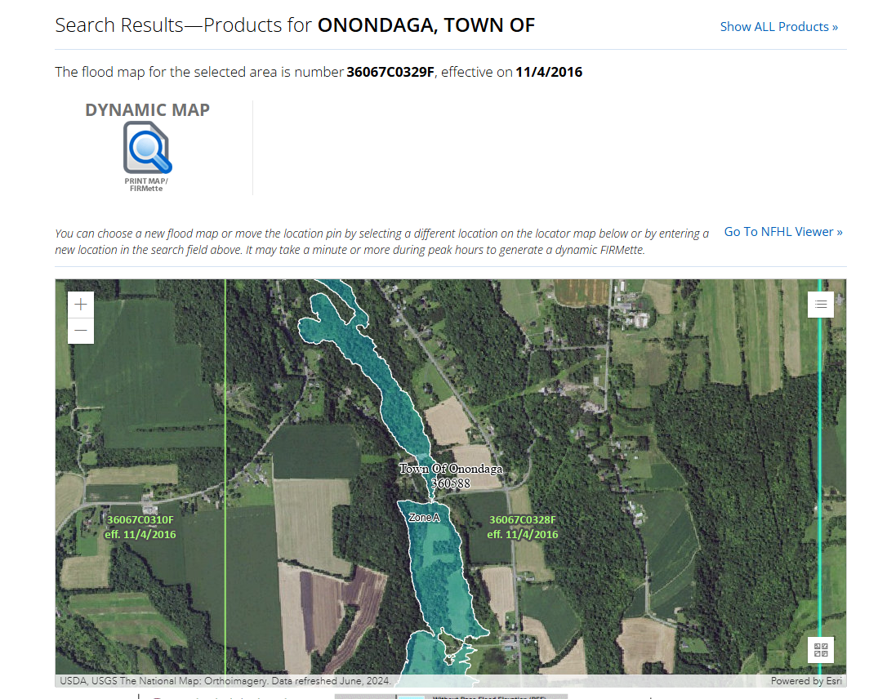
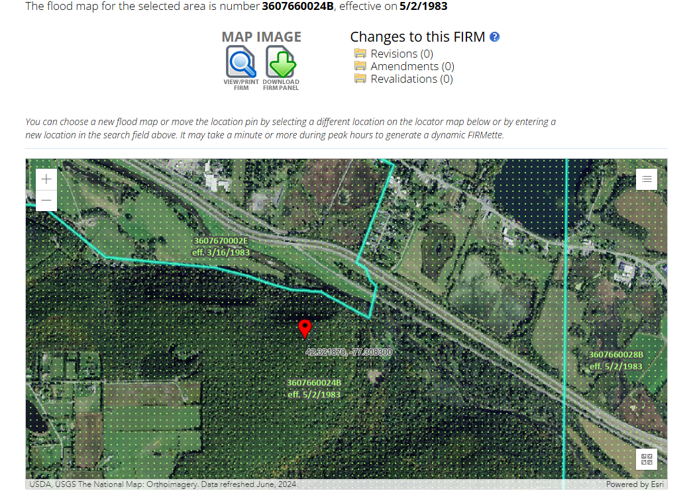
Where to find the maps?
All effective and historic flood maps and studies from FEMA are available online through FEMA’s map service center.
Once on the website, you can enter the property address for the project, and the map viewer will shift to that location. If the effective map is digital, it will show the location with the flood hazard boundaries; if there is no digital map, the area will appear as green dots. Examples of both are shown below.
If there is no digital map, you must select all products in the top right corner to find the paper PDF File.

Slide 5
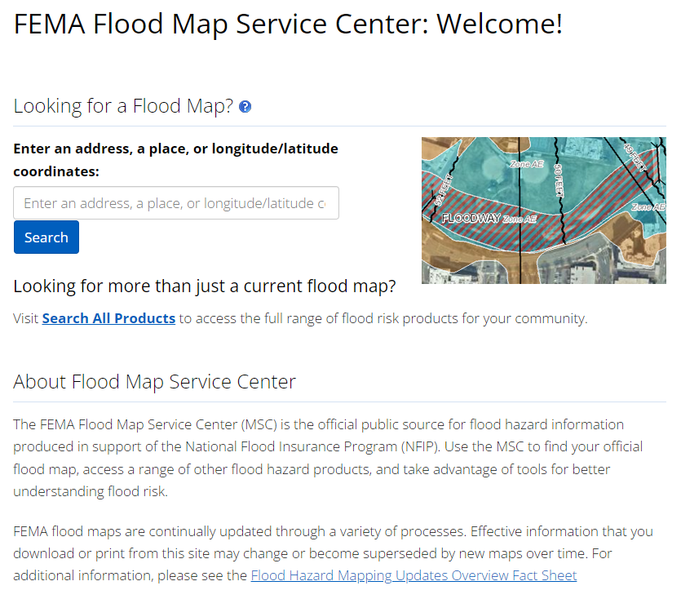
FEMA Flood Map Service Center | Welcome!

Slide 6
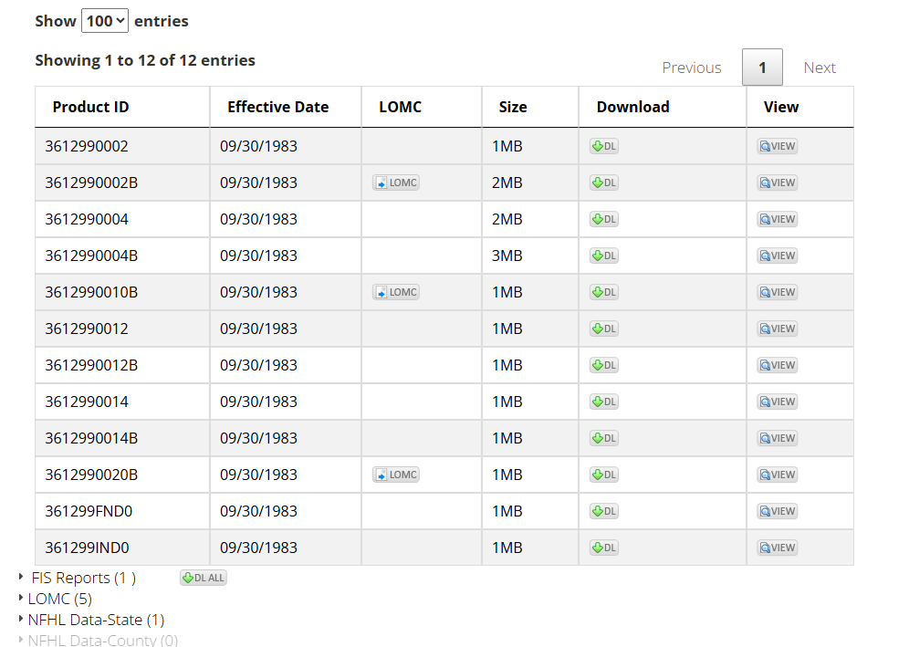
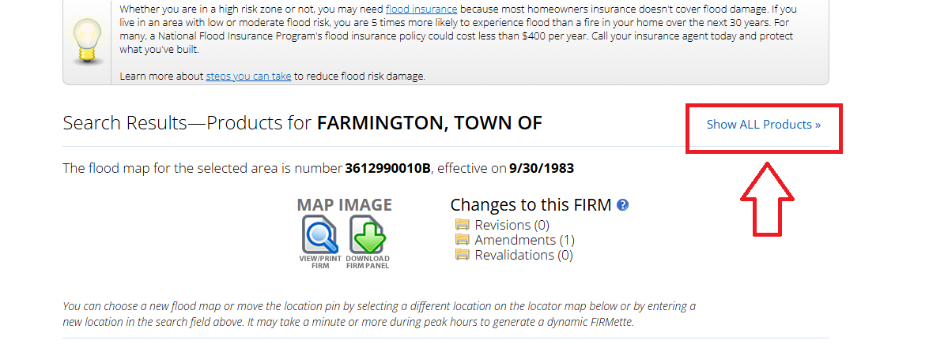
Floodway Delineation
Careful Investigation to determine if the site is in the floodway must be undertaken for all proposed development within a community.
Communities with mapping in NYS dated 1978 to 1986 may have the floodways delineated on a separate map panel. This critical information is not shown when searching by address on FEMA’s Map Service Center. To find the additional panel, search “all products” on the MSC.

Slide 7
Floodway Panel and Flood Insurance Rate Map Panel Examples
Floodway Map Panel
Flood Insurance Rate Map Panel (FIRM)

Slide 8
Floodway
The Floodway is the channel of a river or other watercourse and adjacent land areas that must be kept clear to allow for safe discharge of floodwaters without increasing upstream flood elevations.
All development is prohibited in the floodway unless a hydraulic and hydrologic analysis has been completed showing that there would be no-rise (0.0 feet) in flood stages as a result of the project.
It is important to consider that even if a hydraulic and hydrologic analysis shows that there will be no rise as a result of the project, the project can still be exposed to high volumes of high-velocity flood waters.
All development must be in compliance with all other floodplain management regulations.

Slide 9
Solar Arrays
You must obtain a Floodplain Development Permit from the Local Floodplain Administrator for any man-made change in the floodplain, including but not limited to:
Excavation
Fill
Dredging
Construction of buildings
Installation of utilities
And storage of equipment and materials

Slide 10
Solar Development within the Special Flood Hazard Area
The site construction plans should delineate all floodplain and floodway areas.
AVOID FLOODWAY AREAS IF POSSIBLE
Elevate the lowest edge of all photovoltaic panels, when at full tilt, at least 2 feet above the Base Flood Elevation (BFE) in Zone AE or Zone A1-A30.
Column embedment must be enough to provide structural stability while assuming reasonably anticipated scour during the 1% event.
If it is not possible, a hydraulic and hydrologic analysis must be completed prior to the project taking place showing that there would be no-rise (0.0 feet) in flood stages.
If the site is in Zone A, with no BFEs. The panels must be elevated at least 3 feet above the Highest Adjacent Grade in the full-tilt position.
Note:
If the project site is more than 5 acres and is located in a Zone A floodplain where no BFE is provided, the developer must calculate the BFE for the entire project site.

Slide 11
Road Construction
Roads should be:
Constructed at grade
Bridges and Culverts must be permitted by the community
Any floodway encroachment must have an engineering encroachment review demonstrating no-rise (0.0 feet) in flood stages prior to the issuance of the permit.
If the review demonstrates a rise, the project must be redesigned, or a Conditional Letter of Map Revision must be approved by FEMA prior to the start of construction. The final Letter of Map Revision (LOMR) is required after construction is completed.
In addition to the above requirements, the following must all be elevated to at least 2 Feet above the BFE (or 3 Feet above the highest adjacent grade in Zone A):
Electrical service equipment,
Bottom of structural frame of temporary construction trailers,
Inverter skid platforms, and
Permanent structures.

Slide 12
Additional Construction Requirements
All new construction must be designed and adequately anchored to prevent floatation, collapse, or lateral movement of the structure resulting from flood forces.
All construction below the base flood elevation must be constructed with materials resistant to flood damage and capable of withstanding direct and prolonged contact with floodwaters without sustaining significant damage.
Fencing must provide flow-through for the base flood. Fencing located within the Floodway should be avoided.
Remember: other local, state, and/or federal permits must be obtained, if necessary.

Slide 13
Thank you!
Thank you for attending today’s presentations.
Questions?

Slide 14
Contact Information
Central Office Floodplain Management Coordinators
Main Number, 518-402-8185
Kelli Higgins-Roche, PE, CFM: NYS NFIP Coordinator 518-408-0340 kelli.higgins-roche@dec.ny.gov
Bailey Sawyer, CFM: Lead for Regions 1 – 3 518-402-9148 bailey.sawyer@dec.ny.gov
Brad Wenskoski, CFM: Lead for Regions 5 – 6 518-402-8280 brad.wenskoski@dec.ny.gov
Victoria Agens: Lead for Region 4 518-402-8135 victoria.agens@dec.ny.gov
Forrest Gifford: Program Engineer 518-402-7350 forrest.gifford@dec.ny.gov
Western NY Flood Hub Floodplain Management Coordinators
Assisting with Regions 7-9
Karis Manning, PE: Chief, Western Flood Hub 585-226-5445 karis.manning@dec.ny.gov
Brienna Wirley, CFM: Lead for Regions 7 – 9 585-226-5465 brienna.wirley@dec.ny.gov
Devin Prine: Floodplain Coordinator 585-226-5434 devin.prine@dec.ny.gov

