Slide 1
Planning For Solar Energy Projects
Robert H. McKertich, Esq.
The Law Office of Robert H. McKertich, PLLC
Bob@mckertichlaw.com

Slide 2
Planning For Solar Energy Projects Solar: How to Protect Your Homes and Define Your Community
Robert H. McKertich, Esq.
The Law Office of Robert H. McKertich, PLLC
Bob@mckertichlaw.com

Slide 3


Slide 4
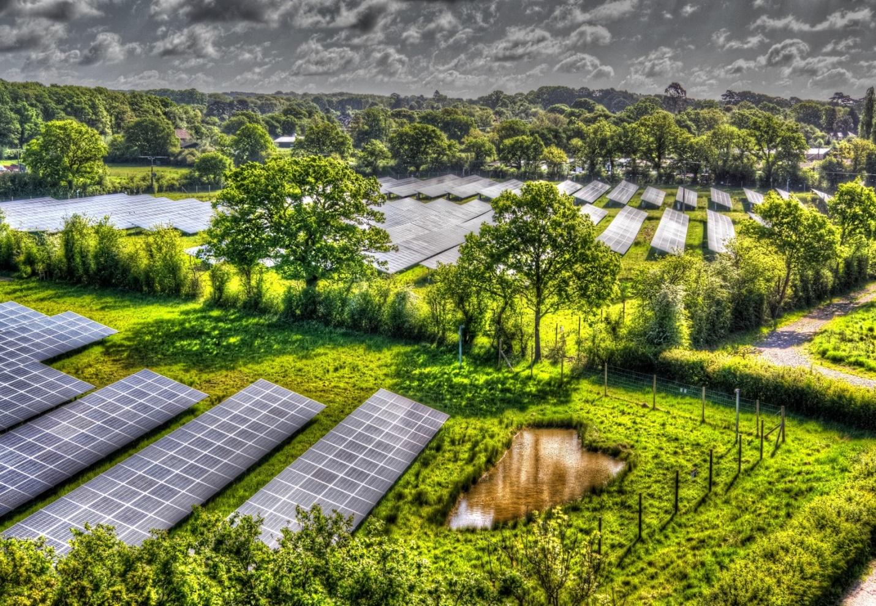

Slide 5


Slide 6
A Common Scenario
A solar developer engages in discussions with the Code Enforcement Officer and submits a plan for a solar project.
The project is around 5-10 MW in a rural area of town.
Your municipality either doesn’t have a solar law, has the standard NYSERDA solar law adopted in 2017, or has solar law that needs updating.
Your comprehensive plan was prepared about 10 years ago. It contains vague statements about promoting solar energy on agricultural lands.
You begin to get phone calls from upset constituents and you feel unprepared…

Slide 7

Step #1: Enact a Land Use Moratorium
A moratorium preserves the status quo while the community considers and potentially adopts changes to its comprehensive plan and/or local laws.
Typically, you want to enact a land use moratorium, not a police powers moratorium.

Slide 8
Step #1: Enact a Land Use Moratorium (Cont.)
All land use moratoria must strictly comply with these 5 standards:
1. The moratorium must extend for a reasonable time frame
6 months to 1 year have been upheld; multi-year moratoria have been overturned at times.
2. The moratorium must have a valid public purpose
Must be actively engaged in updating plans and laws.
3. The burden imposed must be shared by the public at large.

Slide 9
Step #1: Enact a Land Use Moratorium (Cont.)
4. The moratorium must strictly adhere to procedures for adoption of a local law:
Introduce the law to the legislative board to begin the aging process
Send for a GML §239-m review by the County
Send for local Planning Board review (if required by local law)
Schedule and publish notice of a public hearing
Notify neighboring municipalities
Hold the public hearing
Consider SEQR (Type II)
Legislative Board adopts the law by majority (or supermajority) vote
File the law with the Department of State
Post-adoption notice
Work with an experienced municipal attorney
5. The moratorium must have a time certain for expiration.

Slide 10

CP Vestal LLC. v. The Town of Vestal (Index No. EFCA2024003023), May 8, 2025 Litigated by Robert McKertich and Gina Middleton
Solar developer challenged successive solar moratoria enacted by the Town.
The Court found that the Town’s moratorium was a valid exercise of land use power.
Under these particular facts, the successive moratoria was valid because the Town was actively engaged in the land use process.
The “special facts exception” does not apply here. The facts do not show that the Board acted in bad faith, targeted the applicant, or unduly delayed acting upon the application.

Slide 11

Step #2: Update Your Comprehensive Plan
A Comprehensive Plan is a broad-based planning document, which identifies the characteristics and goals of a municipality.
Many Comprehensive Plans either do not address solar development at all, provide vague statements, or are outdated.

Slide 12
Step #2: Update Your Comprehensive Plan (Cont.)
Comprehensive Plans should be updated to identify how solar development fits within the character and goals of your specific community.
Any subsequent solar laws will need to be consistent with the Comprehensive Plan.

Slide 13
Step #2: Update Your Comprehensive Plan (Cont.)
Start with the Town Board
Town Board Establishes a Special Board: The Town Board adopts a Resolution creating a Special Board and directing the Special Board to prepare an Amendment to the Comprehensive Plan regarding solar development. At least one member of the Special Board must also be a member of the Planning Board.

Slide 14
Step #2: Update Your Comprehensive Plan (Cont.)
Then to the Special Board
Special Board Meetings/Hearings: The Special Board holds several meetings and one or more public hearings, as it deems necessary to assure public participation.
Special Board Drafts the Amendment: The Special Board drafts an Amendment to the Comprehensive Plan.
Referral to the Planning Board: The Special Board may refer the Amendment to the Planning Board for review and recommendation before action by the Town Board.
Special Board Recommended Approval: The Special Board adopts a Resolution recommending approval of the proposed Amendment to the Comprehensive Plan. That recommendation is sent to the Town Board.

Slide 15
Step #2: Update Your Comprehensive Plan (Cont.)
Back to the Town Board
Referral to the County: The Town Board refers the Amendment of the Comprehensive Plan to the County Planning Department for a GML 239-m review.
Public Hearing: Within 90 days after receiving the proposed Amendment to the Comprehensive Plan, the Town Board must hold a public hearing.
SEQR Review: The Town Board must declare lead agency under SEQR and conduct a SEQR environmental review with regard to the Amendment to the Comprehensive Plan.

Slide 16
Step #2: Update Your Comprehensive Plan (Cont.)
Approval: The Town Board adopts a Resolution approving the Amendment to the Comprehensive Plan.
Filing: The Amendment to the Comprehensive Plan must be filed in the office of the Town Clerk and County Planning Department.
Local Laws: Following the adoption of the Amendment to the Comprehensive Plan, the Town Board must then update its local laws to be consistent with the Amendment to the Comprehensive Plan.

Slide 17
Step #2: Update Your Comprehensive Plan (Cont.)
Basic Questions when Updating the Comprehensive Plan for Solar:
Do you want to treat residential and commercial solar development differently?
What parts of town do you want to allow for each type of solar project?

Slide 18
Pro Tip: All Comprehensive Plan amendments must take into consideration county agricultural and farmland protection plans as created under article twenty-five-AAA of the agricultural and markets law.
Have you ever read the County’s agricultural and farmland protection plan?

Slide 19

Step #3: Draft a Thorough Solar Law
Step 1: Closely Define What You Are Regulating.
Consider regulating large commercial projects different from small residential projects.
Example (NYSERDA): Tier 1 (25kW), Tier 2 (1MW), Tier 3 (5MW), Tier 4 (+5MW)
Example: Non-Commercial (less than 200 kW) Commercial (more than 200 kW)
Consider different regulations depending upon the type of solar facility proposed.
Ground-Mounted
Roof-Mounted
Building Integrated

Slide 20
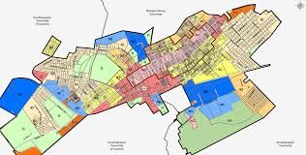
Step #3: Draft a Thorough Solar Law (Cont.)
Step 2: Decide What Zoning Districts Each Solar Facility Is Allowed In.
Common zoning districts include: Residential, Commercial, Industrial, Agricultural
Example: Small scale solar facilities are allowed in all districts
Large scale solar facilities are allowed in Industrial and/or Agricultural

Slide 21
Pro Tip: Freepoint Solar LLC v. Town of Athens Zoning Board of Appeals, 234 AD3d 127 (3rd Dept. 2024)
Solar company owned land in the rural residential zoning district.
The town board adopted a local law prohibiting solar in all districts, except for the commercial and industrial district.
The solar company applied for a use variance, which was denied by the ZBA
The solar company appealed and won in court because, while state law provides a stringent 4-part use variance test:
“applicants that are proposing to develop public utility infrastructure are subject to the ‘public necessity’ use variance test, which sets a lower burden for establishing the applicant’s right to an approved variance … Indeed, ‘it has long been held that a zoning board may not exclude a utility from a community where the utility has shown a need for its facilities.’”

Slide 22

Step #3: Draft a Thorough Solar Law(Cont.)
Step 3: Decide What The Permitting Process Looks Like.
What approvals are required?
Special Use Permit
Site Plan Approval
Both
Just a Building Permit (small-scale projects)
Who issues the approval?
Planning Board
Town Board
Code Enforcement Officer

Slide 23

Step #3: Draft a Thorough Solar Law (Cont.)
Step 4: Establish Standards.
A Check List of standards to include in your law:
þ Setbacks
þ Height Limits
þ Minimum Lot Size
þ Visual Screening/Buffering
þ Lighting
þ Glare
þ Noise
þ Fire Suppression
þ Road Frontage
þ Access Road

Slide 24
Step #3: Draft a Thorough Solar Law (Cont.)
þ Vegetation Management Plan
þ Fencing
þ Utilities
þ Lot Coverage
þ Stormwater Management Plan
þ Decommissioning Plan
þ Financial Security for Decommissioning
þ Host Community Agreement
þ Operating Permit and Fee
þ Insurance
þ Escrow for Legal and Engineering Fees
þ Enforcement

Slide 25
What I call, the Use Variance Contingency Strategy:
Given the relaxed public utility use variance standard, consider a provision calling for increased area requirements (such as setbacks, lot size, etc.) for any project that receives a use variance in a residential zoning district.

Slide 26

Step #3: Draft a Thorough Solar Law (Cont.)
Step 5: Follow the Local Law Approval Process Strictly.
This includes steps such as: public notice, public hearings, SEQR, GML 239-m, etc. Work with an experienced municipal attorney.

Slide 27
FINAL THOUGHTS
Section 487 of the Real Property Tax Law provides a 15-year exemption from real property taxation for solar energy systems. Each municipality may decide whether to offer the exemption. But unlike most tax exemptions, this exemption automatically applies, unless the municipality opts-out.
The RAPID Act, enacted in April 2024, consolidates the environmental review, permitting, and siting of major renewable energy facilities under the purview of the Office of Renewable Energy and Siting (ORES). Major renewable energy projects are considered projects 25 megawatts or larger.
Special use permitting boards must be trained on how to handle these projects. They do the heavy lifting.
Questions?

